Slide 1
COMP1003 – Algorithms, Data Structures & Mathematics Lecture Run-Time Complexity of Code
Thomas Wennekers
University of Plymouth

Slide 2
The Problem
Data-intensive tasks need efficient algorithms
Real-time applications also need fast algorithms
Audio, video, games
Data-bases, web-services, search engines
Image processing, surveillance
Artificial intelligence, neural networks

Slide 3
Aims and Objectives
Introduce the O-notation for time complexity
Explain different complexity classes and how to estimate the run-time of some algorithms
Demonstrate how to measure program run-time for a number of examples
Develop an awareness when run-time issues are important (“bottlenecks”)

Slide 4
Outline
Example: the travelling salesman problem
Simple run-time measurement in C#
O-Notation
Several examples of growing time-complexity

Slide 5
The Travelling Salesman Problem
Given N cities with given distances, find the shortest route that visits each city precisely once.

Slide 6
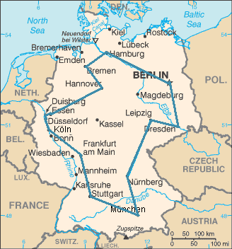
Travelling Salesman Problem (15 largest German towns)
One solution is exhaustive search … try all possibilities and select the minimum
Similar problems occur for drilling holes in printed boards, computational genetics, and more

Slide 7
Exhaustive Search is Expensive!
Let us calculate the number of round-trips:
Choose the first city; there are N possibilities
Choose the second city; there are N-1 possibilities
…
Choose the last city; there is one left
In total we have N! = N*(N-1)*....*1 possibilities

Slide 8
The Factorial Function Grows Fast
2! = 2 for comparison
3! = 6 1M = 1.000.000 = 10^6
4! = 24 1G = 1.000.000.000 = 10^9
5! = 120 1T = 10^12
10! = 3.628.800
15! = 1.3077e+12 (typical HDD size: 1TB)
20! = 2.4329e+18
Computer can't solve problems bigger than N=20

Slide 9
Travelling Salesman Problem
It is believed that the run-time can not scale better than exponential, 2^N
There are heuristic and approximate solutions that can be faster but find sub-optimal solutions
Largest problems solved are around several 10.000 “cities”, sometimes even more

Slide 10
Good News:
Many useful algorithms are more efficient

Slide 11
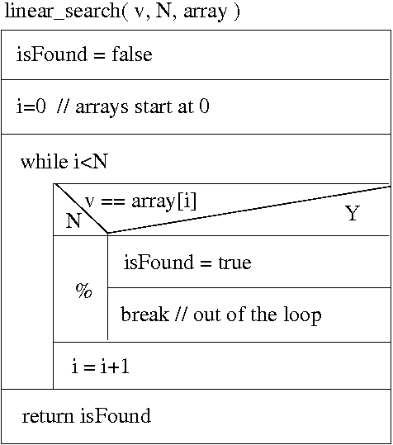
Linear Search
Task:
find v in array of size N
informal solution:
iterate through the array;
if v is found return “true”
else return “false”

Slide 12
How many times around the loop?
Could be the first element
Could be the second element
…
Could be the last element
Could not be there at all
→ the best case is 1
→ the worst case is N
→ the average case is more complicated

Slide 13
How much Time?
Suppose we need A units of time for each iteration
Suppose we need B units of time for initialisation and termination of the loop
So, the time taken for j iterations is A * j + B
the worst case time is A * N + B
and the average case time is 1⁄2 * A * N + B
Assuming that all keys are present and equally likely
but ? how to weigh in the possibility of absent keys ?

Slide 14
T(N) = A*N + B
What happens to the time as N gets bigger and bigger?
– B hardly matters as N gets larger
– A is more important
– But the really important fact is that the time taken is directly proportional to the size of the array N
If N doubles, the time taken doubles
If N trebles, the time taken trebles
If N is multiplied by 10, so is the time taken
→ Ignore constants, only consider the factor order, N

Slide 15
The O-Notation – O(N)
O(N) means that the Order of the algorithm is N where N is the number of data items
If the size of the problem increases, the run-time increases about proportionally (“linearly”)
The run-time, more precisely, is A*N+B, but A and B are constants that depend on the implementation, the compiler, the computer...
A and B are also often difficult to determine
We say this is an O(N) algorithm

Slide 16
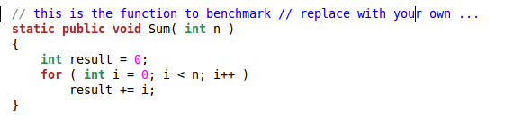
Time Measurements in C#
Example: benchmark the addition of integers:
→ try this in the labs

Slide 17
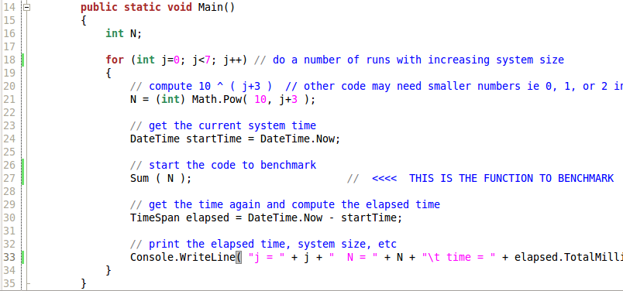
Simplest Benchmarking Code

Slide 18
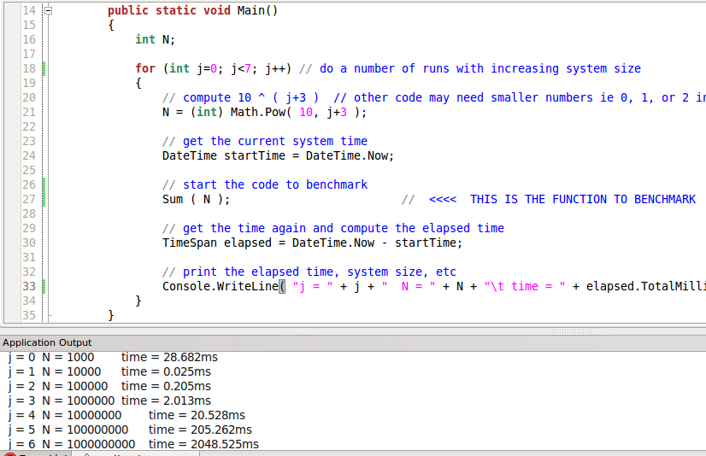
Benchmarking for increasing N
Artefact (DLL loading?)
linear increase

Slide 19
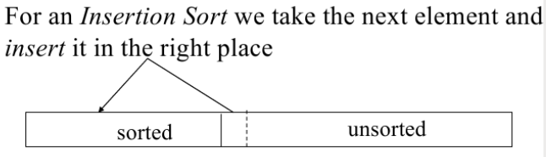
Another Problem: Speed of Insertion Sort (from Practical about Iteration)

Slide 20
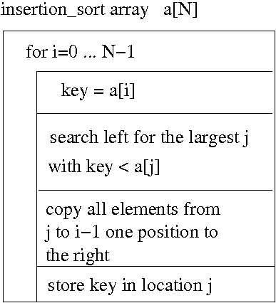
Insertion Sort Structogram
← outer loop
← here is a 2nd nested loop required
← and another one in series with the 2nd

Slide 21
What's the Complexity?
We iterate through the array from left to right
→ N iterations through outer loop
In each main iteration we search for a minimum in a sub-array of size N/2 on average and copy proportional to N elements
→ order N operations per outer iteration
The total effort is proportional to N*N = N^2

Slide 22
Insertion Sort is O(N^2)
We say “Oh-N-square” or “quadratic complexity”
The effort increases quadratically with the number of elements to be processed
N N^2
1 1
10 100
100 10000
1000 1000000

Slide 23
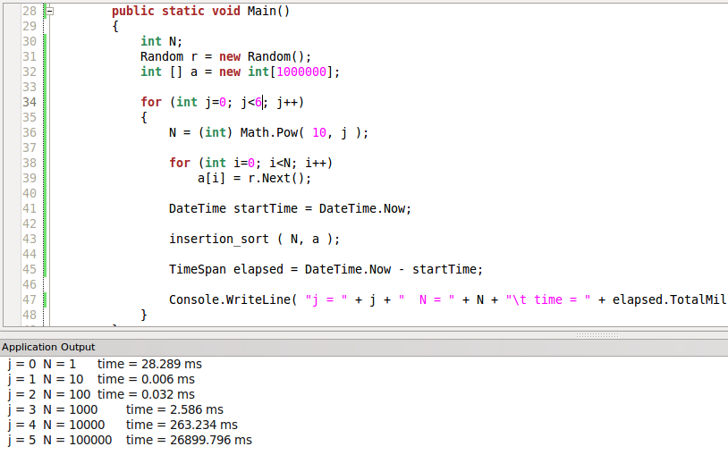
Insertion Sort Benchmark Code
random numbers to sort
for code see practical 5
observe quadratic progression

Slide 24
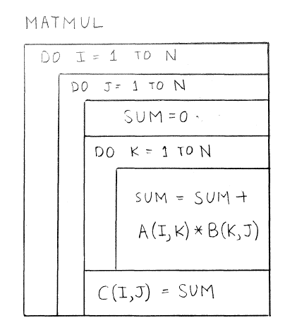
Matrix Multiplication – Structogram
← outer loop
← 1st nested
← 2nd nested

Slide 25
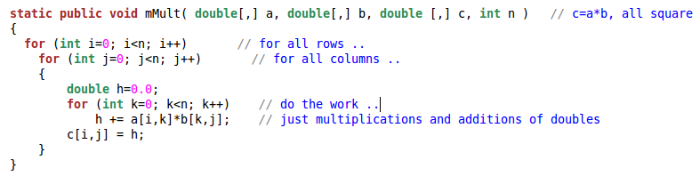
Matrix Multiplication – Code

Slide 26
Matrix Multiplication
We have three nested loops of length “N”
The algorithm has “cubic complexity”
We say it is of order N^3, O(N^3), O(N³)
Note: faster algorithms are known, e.g.,
“Strassen algorithm”, O(N^2.81)

Slide 27
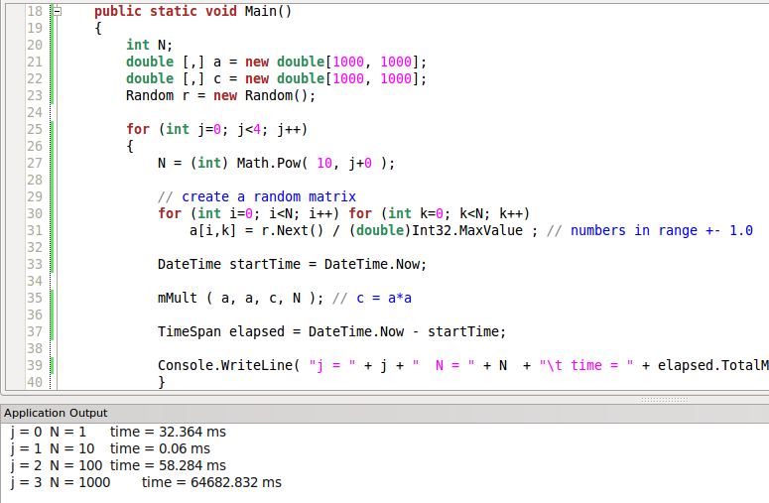
Matrix Mult – Benchmarking Code
N=1000 needs already 1 minute

Slide 28
Polynomial Time Algorithms
O(N^{k}) or O(N^k) , “oh-N-to-the-power-of-k”, are algorithms that run in “polynomial time”
for N elements their effort is proportional to the k-th power of N, i.e., the k-th product of N with itself, N*N*...*N, k times
“P” is the class of all polynomial time algorithms
… the algorithms of hope …

Slide 29
Good News – There are very fast algorithms

Slide 30
Good News – There are very fast algorithms
(… but not for all problems)

Slide 31
O(1) – Constant Time
“Constant time” or O(1), “oh-one”, means the run-time of an algorithm is independent of the elements to process

Slide 32
O(1) – Constant Time Example
With respect to element insertion, a queue using a circular buffer is more efficient in the worst case, ie O(1), than a queue using data shuffling, ie O(N).

Slide 33
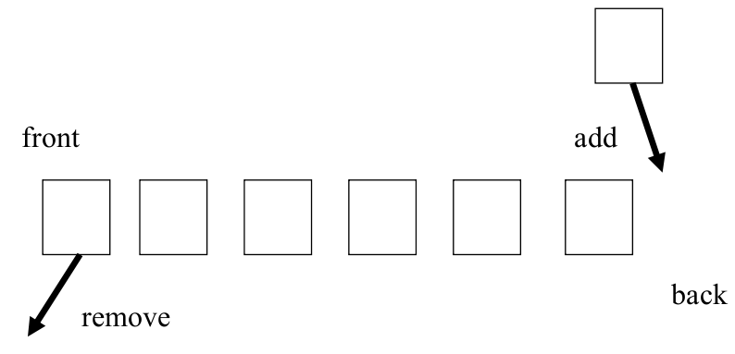
The Queue ADT

Slide 34
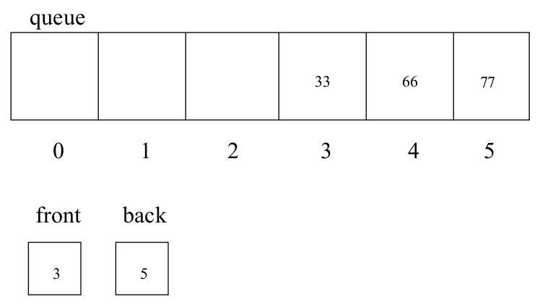
Array-Queue reaching end of memory space

Slide 35
Two options …
shuffle data to the left
use a ring-buffer

Slide 36
Complexity?
Shuffling needs O(N)
the precise factor depends very much on the available (fixed size) memory space and the rates of reading and writing data
Circular buffer needs O(1) – CONSTANT TIME
all that has to be done is to detect the full buffer and reset the front and back indexes to 0

Slide 37
“Amortised” Complexity
Shuffling is only required sometimes, i.e. if the queue reaches the upper boundary
Most of the time, adding to the array-queue is O(1) as for the ring-buffer implementation
Amortised complexity considers the total run-time per element to process
This is O(1) for both implementations, the array-queue and the ring-buffer (but the constant factor (A) is bigger for the array-queue.
Note: Average complexity makes probabilistic assumptions; amortised complexity is typically “worst case”

Slide 38
Bad News: It can get much worse than O(N^k)
(for any k)

Slide 39
Exponential Time Algorithms
Consider logical expressions (see assignment)
(a&&b) || c → c || a && b
Is this satisfiable? Are there any truth-values for a, b, c that make the expression true?

Slide 40
Exponential Time Algorithms
Consider logical expressions (see assignment)
(a&&b) || c → c || a && b
Is this satisfiable? Are there any truth-values for a, b, c that make the expression true?
This is in general a “difficult” task

Slide 41
General solution procedure:
enumerate all possibilities (true,false) for all variables (F,F,F), (F,F,T), (F,T,F) … (T,T,T)
check the expression's value
N variables; two truth values → 2^N possibilities
this problem is O(2^N) – “exponential” complexity

Slide 42
Log-Time Algorithms – O(log N)
Remember from school:
a^{x} = y → x = log_{a} y
The logarithm grows slowly
10 = 10¹ log₁₀ 10 = 1
100 = 10² log₁₀ 100 = 2
1000 = 10³ log₁₀ 1000 = 3
...

Slide 43
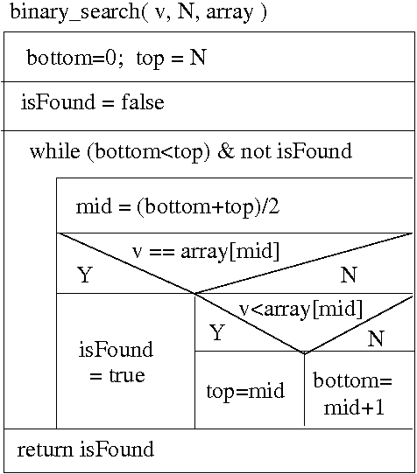
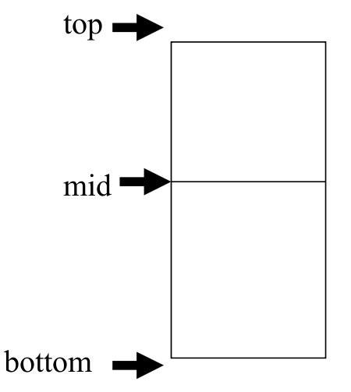
Binary Search

Slide 44
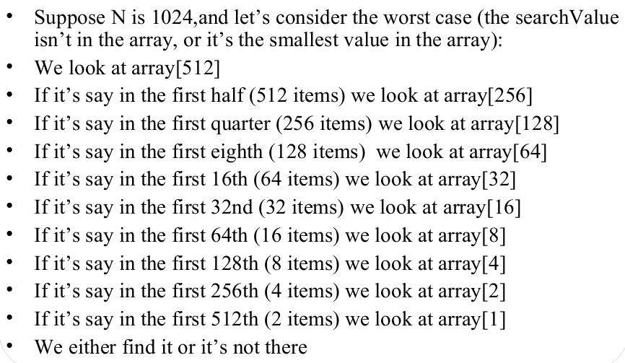
How much work?

Slide 45
How much time?
Suppose that (in the worst case for an array size of N) we went through the loop k times
Each time round the loop we reduce the size of the array we look at by half
So, the time complexity is T(N) = A*k + B
where 2^{k} = N or k = log₂ (N) (dual logarithm)
T(N) = A * log (N) + B
This is an “oh-log-N” algorithm, O(log N)

Slide 46
O( log N ) Algorithms
log N is to N as N is to 2^N
log N grows much! slower than N
O(log n) algorithms are therefore very fast
As N gets bigger log N grows like the number of bits required to represent N
The loop body is more complex than for linear search; the factor of N is therefore bigger
for small numbers of N, linear search is faster

Slide 47
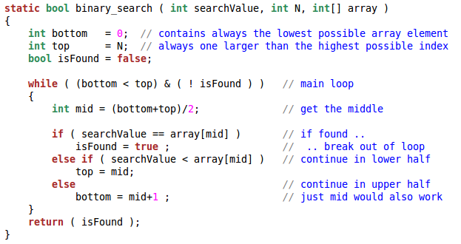
Binary Search Code (from earlier lecture)

Slide 48
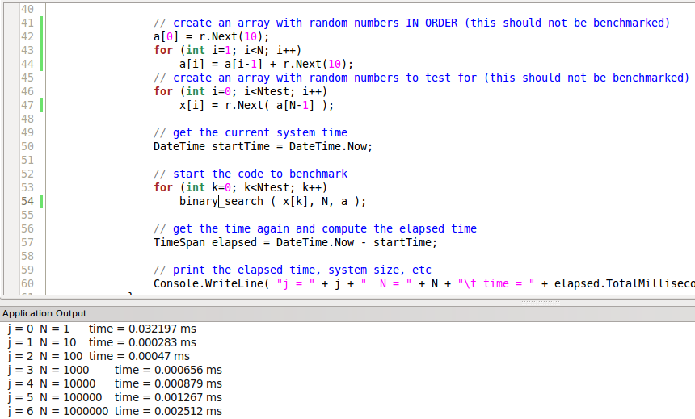
Binary Search Benchmark
create ordered random numbers
and random test data
note the tiny run-time

Slide 49
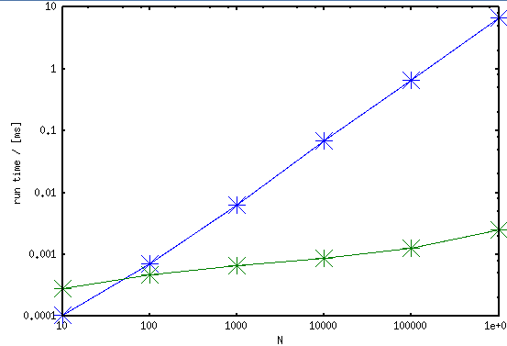
Binary versus Linear Search
Note the double logarithmic axes

Slide 50
O(N log N) Algorithms
An O(N log N) algorithm is better than O(N^2) but (slightly) worse than linear, O(N)
Insertion sort is O(N^2)
There are O(N log N) algorithms to sort an array of N elements (e.g., quick-sort and merge-sort)
It can be proven that sorting in the general case can not be faster than O(N log N)
See later lecture on searching and sorting

Slide 51
Recap
Queue insertion is O(1)
Binary search is O(log N)
Linear search is O(N)
Insertion sort is O(N^2)
naïve Matrix multiplication is O(N^3)
Boolean satisfiability is O(2^N)
Brute-force Travelling salesman is O(N!) = O(N^N)

Slide 52
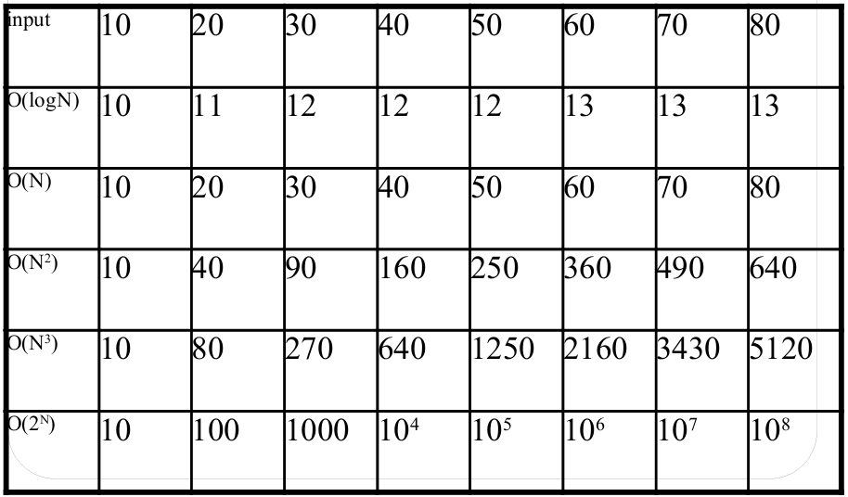
Recap
Note: factors and constants are unimportant

Slide 53
Rules of Thumb for O()
Running time for a loop is the number of iterations times the running time of operations within it
“Operations within” can be loops → multiply by N
Assume the average or the worst case (i.e., never break out of a loop early)
Only the highest factor counts: 3N²+5N+7 ~ N²
Easiest guess: Count only iterations of nested loops

Slide 54
Example: Matrix-Multiplication
Three nested loops of size N → O(N^3)

Slide 55
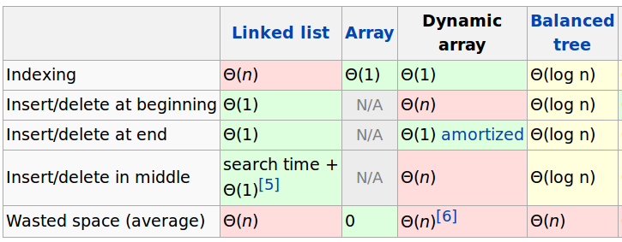
Complexity of Linked Lists and Arrays
Complexities for the doubly-linked list are the same
A dynamic array can increase at the end
Trees we do next lecture

Slide 56
Outcomes
The concept of time-complexity
The big-Oh-Notation
Examples for algorithms of different complexity
O(1), O(log N), O(N), O(N log N), O(N²), O(N³), … O(2^{N}), O(N!) ~ O(N^{N})
Awareness of run-time issues

